Slide 1
CURELAN TECHNOLOGY Co., LTD Quantitative Logarithmic Transformation-Based Intrusion Detection System (QLT-IDS) CureLan FM Series
CURELAN TECHNOLOGY Co., LTD
www.CureLan.com

Slide 2
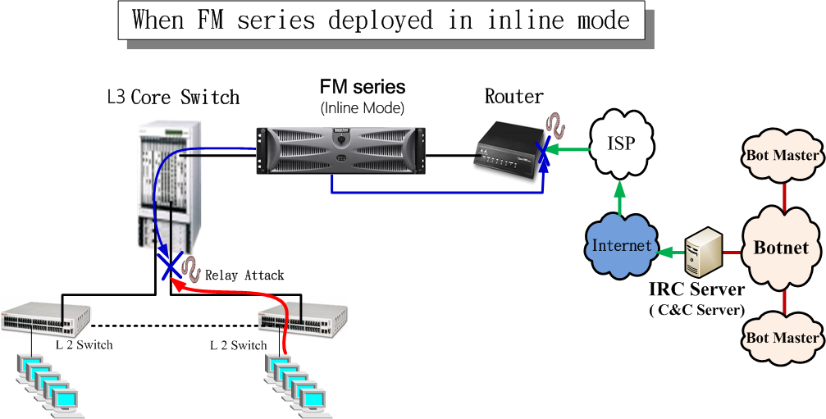
The FM series can be deployed in inline mode to prevent the cyber-intrusion and the cyber-attack
When the hackers use the devices on the relay attack, the FM series will detect and send the ACL commands to the core switch automatically to block this attack.
The FM series will block the hackers automatically by sending the ACL commands to the switch while they try to attack the intranet.
Hackers will try to compromise the
computers on the intranet by a range of methods such as exploiting vulnerable Apps, spear phishing, etc. They use the infected machines to compromise other computers or servers on the network.
There are two ways to automatically block the attacks from the hackers.
◎ The FM series can automatically block the attacks from the hackers.
◎ The FM series can automatically send the ACL commands to the Core Switch to block the attacks from the hackers.

Slide 3
Analyzing the Technology of the IPS Equipment
Intrusion Prevention System(IPS)：
The function of Intrusion Prevention System Signature
Pattern Need to update the pattern
The method of detection DoS function Threshold
Setting the maximum number of packets for each IP address per second.
That means it will count the total number of each IP address, for example, the number of udp_src_session and the number of udp_dst_session. There is a very high false positive rate problem with this function. Because there are so many opportunities in life that we used the UDP packets, such as the Voice, Media Stream, the Domain Name System(DNS) and Network Time Protocol(NTP).
The most common equipment on the market are using the technique that we just mention, including IBM Tivoli ISS, CISCO Source Fire, McAfee, FortiGate, PALOALTO, Juniper, Check Point, Arbor Networks DS_Pravail and so on.
using

Slide 4
Analyzing the Technology of the FM series
The Quantitative Logarithmic Transformation-Based Intrusion Detection System (QLT-IDS) - FM series ：Inline Mode Structure
FM series NBA(Network Behavior Analysis) IP
NBAD(Network Behavior Anomaly Detection) Collect the information of each IP address to analyze the anomalous packet in the network.
Network Behavior Anomaly Detection (NBAD):There are lots of companies which forwarded their product in this way. The structure that they used is using the Database software to collect the information of IP, such as MySQL, Oracle. These Database software are not poor, but they are not good tools for this purpose. There may be more than ten billion records, so the performance of these Database software will be poor.
The FM series use the mathematical algorithms which developed by Curelan company. With the mathematical algorithms, the FM series can collect and analyze the information of the NetFlow or sflow by each IP address very quickly. And then, the FM series can distinguish the anomalous packet from the information that it received.
There are some articles
about NBA in IEEE
evolution

Slide 5
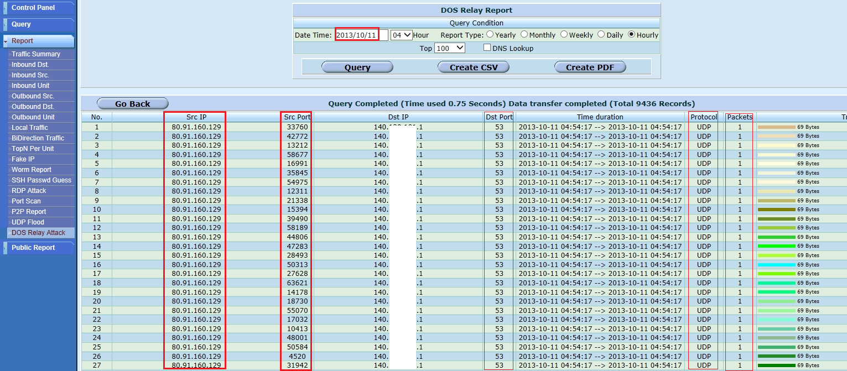
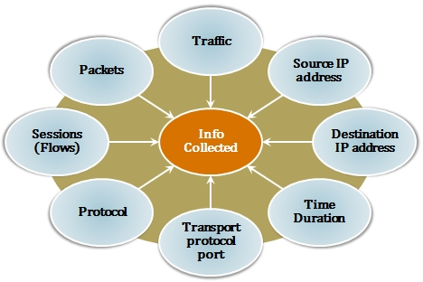
The FM series can receive Netflow (sFlow) and
analyze the data which provided by Netflow

Slide 6
The difference between the FM series and other IPS/IDS products
 | FM series | IPS/IDS products
Architecture | Inline Mode / Listen Mode | Inline Mode
Analysis | Anomaly based | Signature based
Scope | WAN LAN LAN LAN | WAN LAN
Technology | • IP-NBAD (IP-Network Behavior Anomaly Detection) Collect the information of each IP address to analyze the anomalous packet in the network. • Unique Algorithm | • Type filters (like pattern) • Other Threshold

Slide 7
The FM series can protect the network from the cyber-intrusions and the cyber-attacks
The FM series have the ability
to detect kinds of cyber-intrusion
and cyber-attack by
analyzing the detail
information of each
IP.
Port Scan
RDP
Cyber-Intrusion
SSH
Worm
UDP flood attack
DoS attack
Cyber-Attack
DNS attack
NTP attack
MSSQL attack
Telnet attack

Slide 8
The difference between cyber-intrusion and cyber-attack
Cyber-Intrusion
Like a thief
Use small packet traffic
Afraid of being discovered
Cyber-Attack
Like a robber
Use the amount of traffics and a number of flows to paralyze the computer networks
Not afraid of being discovered because hackers may “borrow” these IP addresses

Slide 9
Major Functions
Automatically block infected IPs from L3 Switch by ACL (for Cisco, Foundry, Alcatel and Extreme) or block by FM series (in inline mode).
RDP and SSH password guess detection and blocking.
Port Scan, worm and Inner Intrusion detection and blocking.
UDP flood, DOS, DNS, Telnet and NTP attack detection and blocking.
Provide kinds of intrusion/attack report:
RDP password guess, SSH password guess, Port Scan, worm, Inner Intrusion, UDP flood, DOS, DNS, MSSQL, Telnet and NTP.
Netflow or sFlow traffic report.

Slide 10
Reports
The FM series can provide a lot of report, including the report of Inner Intrusion, RDP, SSH, Port Scan, worm, UDP flood, DOS, DNS,NTP, Telnet, MSSQL attack report and the network traffic reports.
Under “Query” → “Daily Graphic”, the administrator can check
what happened from the “Abnormal traffic matrix”.

Slide 11
real case

Slide 12
How can hackers paralyze the websites and network? They may use the following two methods.
1. The hackers will use the huge network traffic to cause the network congestion problem. Usually, the network bandwidth that the unit bought is a fixed commodity. Therefore, the hackers will generate a number of packets to raise the network usage. Once the network usage exceeds the bandwidth, everything on the network slows down. As the result of the accident, their network or websites will be paralyzed.
Our solution: The units need to provide the attacker's IP addresses to the upstream ISP so that the Internet service provider can solve this kind of problem. The IPS equipment with threshold technique cannot provide the attacker's IP addresses. That is the reason why we use the collected IP data to distinguish the cyber attacks/intrusions. It can find out the attacker's IP addresses via this technique. These IP addresses can be provided to the upstream ISP so that they can block that malware traffic and solve this problem. For example, the Akamai Cloud Delivery Platform suffered the Memcached Servers Deliver Amplified DDoS Attacks via port 11211. If they can provide those attacker's IP addresses to the upstream ISP and ask them to block the traffic from those IP addresses, that problem can be solved. It is quite easy to solve the problem of network paralysis. So it is a practicable method for solving the problem of network paralysis by using the collected IP data.

Slide 13
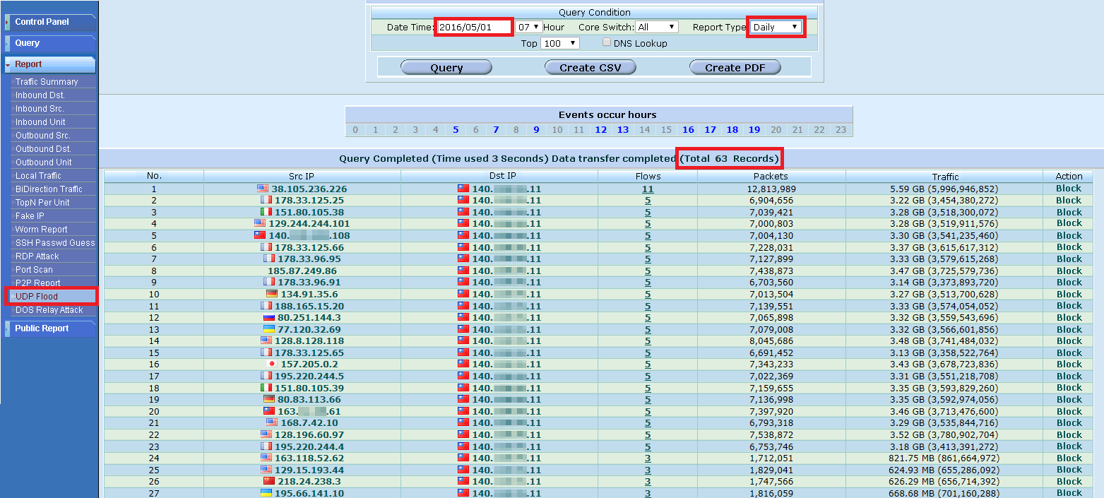
Real case
The unit suffered the number of traffic attack on May 1st, 2016. The bandwidth that the unit bought is 3 Gbps. There were 63 different IP addresses being used to launch the attack. The network administrator gave the list of known attack source IP address to the upstream ISP to block them. The network congestion issues were solved. It is so easy to solve the problem of network paralysis by this method.

Slide 14
How can hackers paralyze the websites and network? They may use the following two methods. (cont.)
2. The hackers will use a number of flows to attack their target. When the unit suffered a lot of attacking flows, all inline network devices need to receive those anomalous packets and forward them to their destination. It will cause the high RAM and CPU usage problem. As the result of the accident, the device which has a bad performance will have the system crash problem and cause the internet disconnected problem.
Our solution: Using the collected IP data to find out those attacker's IP addresses and then add the deny command to the Access Control List (ACL) on the router. It can solve the problem of network paralysis.

Slide 15
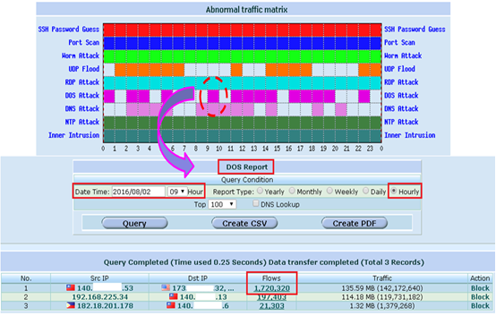
Real case
The IP relay address generated 1,720,320 flows. The hardware resources of the Core Switch were consumed by these flows. The high CPU usage will influence the performance of switching packets. As a result, the network will be paralyzed. Once you know the relay IP address, which means you can use the device that is used to collect IP to automatically send ACL (Access Control List) commands to the Core Switch. You can apply the deny command to the inbound interface to avoid the CPU resource was consumed by those anomalous flows.

Slide 16
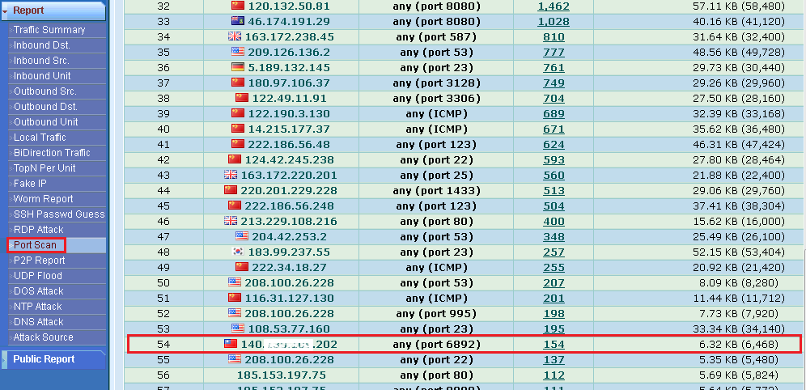
The real case of the port scanning
The FM series can detect and block the intrusion of port scanning. It can detect the relay intrusion to intrude the external IP address. As the following figure shows, the source IP are external IP addresses except the entry outlined in the red column. This entry shows the relay intrusion from internal IP to external IP address.
The ransomwares will scan other hosts via port 6891 or port 6892. The entry outlined in the red column shows the FM series can detect and block this kind of intrusion.

Slide 17
The real case of the SSH & RDP intrusion
The FM series can detect both SSH and RDP password guessing attack.

Slide 18
The real case of the DOS attack
The administrator can see the information of the attack by clicking the block on the abnormal traffic matrix.

Slide 19
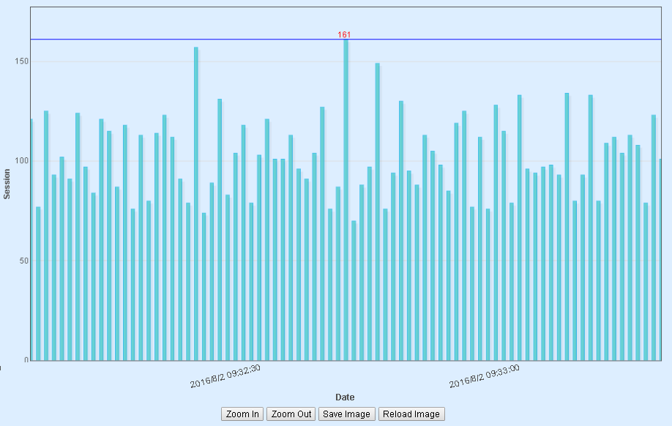
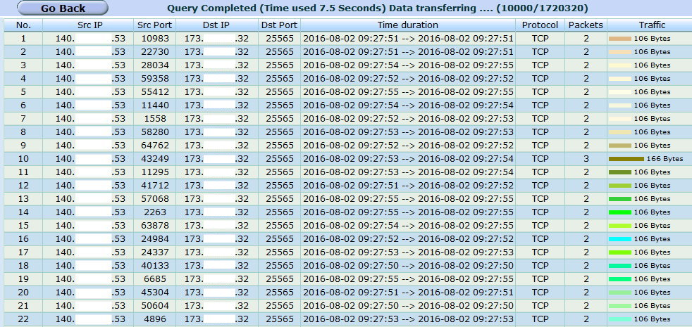
The real case of the DOS attack (cont.)
If the administrator wants to see the detail information of the attack, he can zoom-in by clicking the number of Flows.

Slide 20
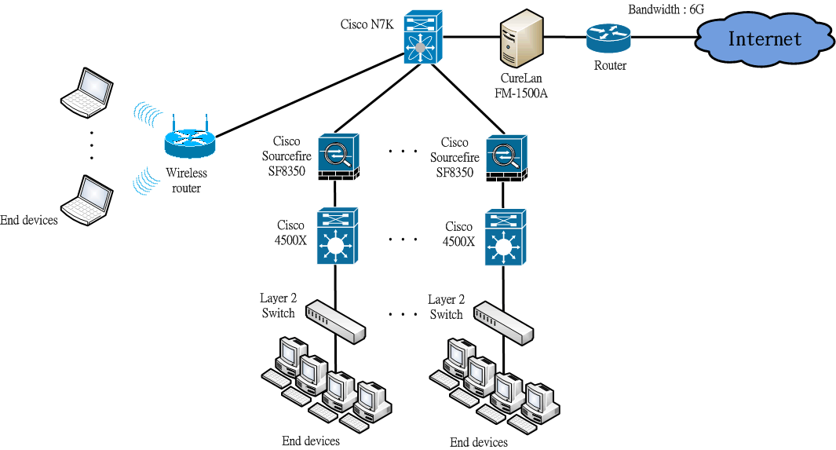
Compare FM series with IPS product
The following figure is the campus network architecture of the university in Taiwan.

Slide 21
Case 1
The following figure showed the FM series detected a anomalous event. A external IP(45.63.127.17) was used to intrude the internal device(140.*.*.247).. We can know the external device located in Japan.

Slide 22
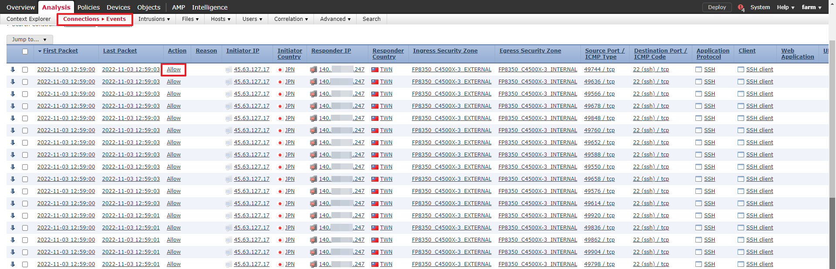
Case 1 (cont.)
The IPS device did not detect this intrusion.

Slide 23
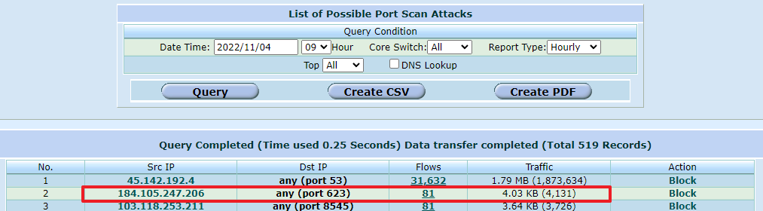
Case 2
The following figure showed the FM series detected the port scanning. A external IP(184.105.247.206) was used to intrude the internal device via port 623. We can know the external device located in America.

Slide 24
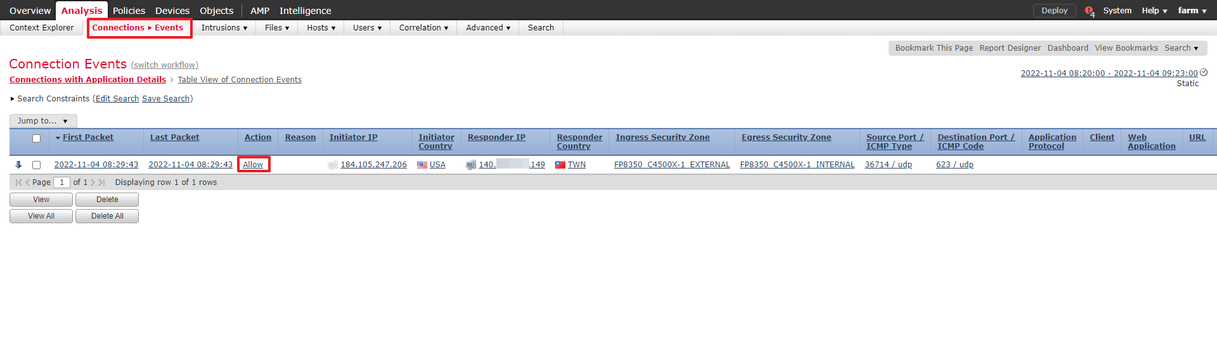
Case 2 (cont.)
The IPS device did not detect this intrusion.

Slide 25
The real case of the UDP flood attack
The administrator can see the information of the attack by clicking the block on the abnormal traffic matrix.

Slide 26
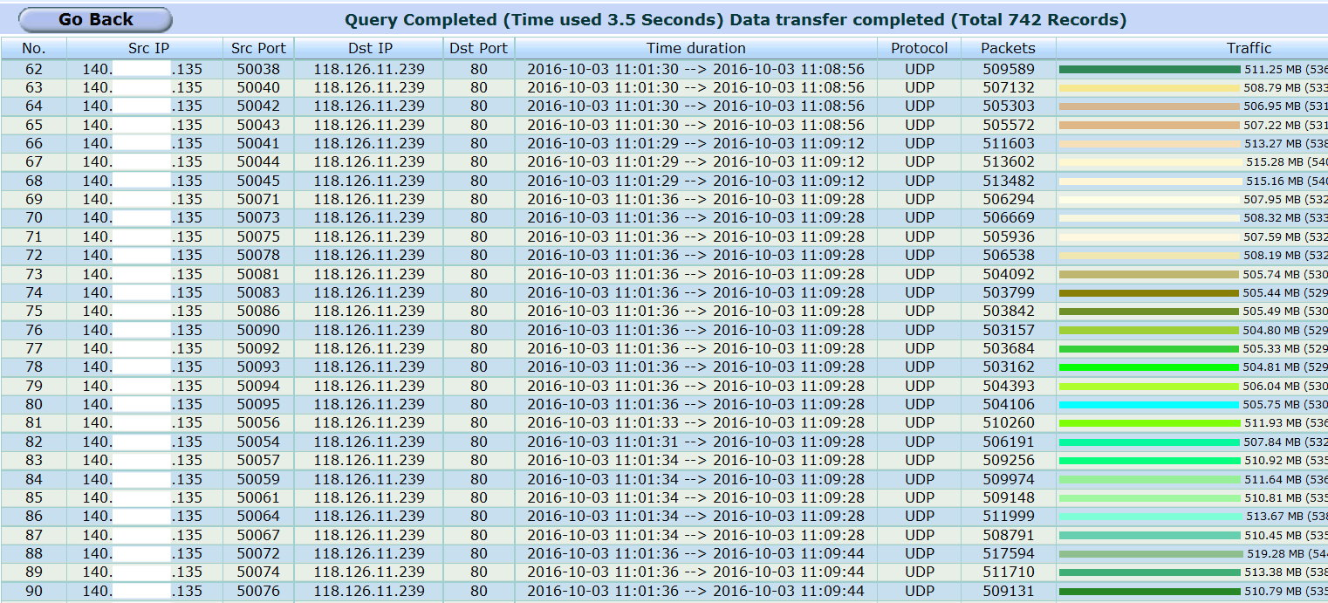
The real case of the UDP flood attack (cont.)
If the administrator wants to see the detail information of the attack, he can zoom-in by clicking the number of Flows.

Slide 27
The real case of the DNS attack
The administrator can view the information of the attack by clicking the block on the abnormal traffic matrix.

Slide 28
The real case of the NTP attack
The administrator can view the information of the attack by clicking the block on the abnormal traffic matrix.

Slide 29
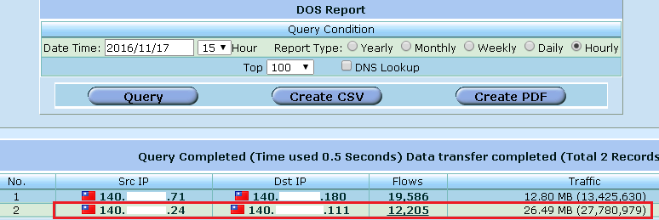
Web Attacks
A internal DoS attack happened in a university on November 17, 2016. The target is the distance learning server. The following figures show the attack at that time.

Slide 30
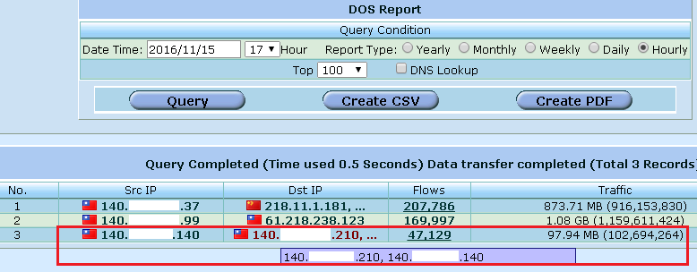
Web Attacks (cont.)
A internal DoS attack happened in a university on November 15, 2016. The target are the web server and the school administration system. The following figures show the attack at that time.

Slide 31
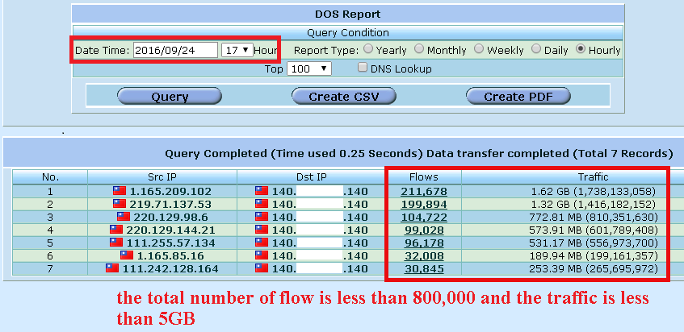
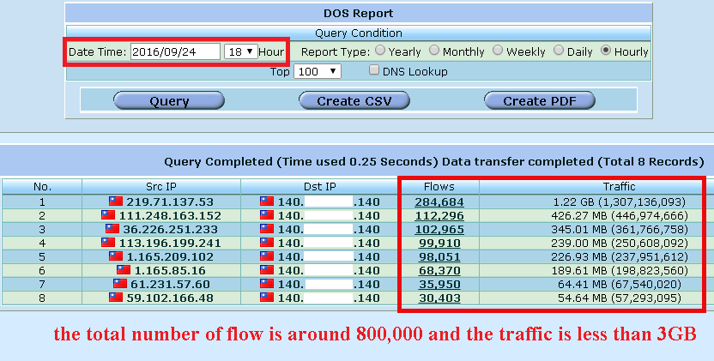
Web Attacks (cont.)
One of the school authority found the campus network was nearly paralyzed on September 24, 2016. The following figures show the attacks at that time.
Generally speaking, these attacks should not cause any serious poor performance issue. However, that causes two inline network devices with poor performance problem in the real world. This case shows the network equipment's insubstantial parts.

Slide 32
Conclusion of Web attacks
From the three cases that we just mention, we can know：
The FM series can detect and block the Web attack so that the web server will NOT be paralyzed.
The FM series can detect and block the attack with huge connection in a short time.
The FM series can detect and block the attack with Slow DOS attacks.
The hackers can use program to avoid producing too much connection. They can either use slow DoS attack to escape from the threshold function of IPS, so that they can successfully attack the target. No matter what kind of method the hackers choose, the FM series can detect and block the attack.

Slide 33
Inner Intrusion
The Russian hacking groups steal money from banks and rigged ATMs to spew cash across the world. Because the ATM system is a closed network system, the method that they can use is intruding from intranet to intranet.
I think we can make a reasonable guess that it may be due to the cooperation of the inside staff. He will invade other computers from intranet so that the police cannot track down his IP and then use the victim computer hacking the ATM service center. After the intrusion succeed, he can send cash spewing to the ATM and appoint people to take the money.
The First Commercial Bank heist in Taiwan can be solved because the police found the face of the people who take money from the cctv. That makes the police know who the suspects are right away. As a result, they found the money but not the people who hide in the dark side.
If the First Commercial Bank uses the FM series product, they can detect the intrusion from intranet to intranet by the Inner Intrusion detection function. They can block the intrusion and find out the source IP addresses.

Slide 34
Inner Intrusion (cont.)
In Taiwan, a secret unit of government uses the closed network. They used the Flowviewer and found out the intrusion by the inner intrusion detection function. The spies were caught in the end.
The secret unit of Taiwan's government uses the closed network ; the ATM system is a closed network system, too. I think the method that the hackers used is the same. The only difference is that the Trojans horse programs they used. The hackers always use the latest version of program. That means the pattern is not be defined, so the device of IPS cannot detect these intrusions.
The Inner Intrusion detection function is unique and available only in Flowviewer. A unit used the Flowviewer to find out the spies who tried to intrude from intranet.

Slide 35
The real case of the Inner Intrusion
The administrator can see the information of the attack by clicking the block on the abnormal traffic matrix.

Slide 36
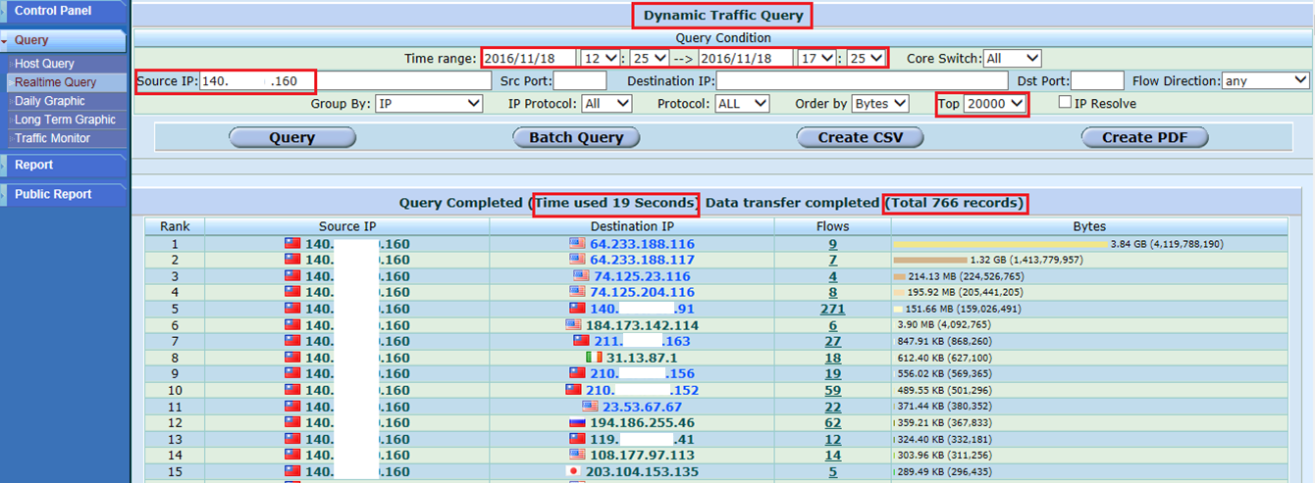
The function of real-time query
After setting the query condition and pressing the query button, you can get the IP addresses that this specific IP has contacted during the period. This function can identify the details of any potential crime and be used as evidence later on.
The following figure shows the source IP (140.XXX.XXX.160) and lists the destination IPs it contacted during November 18, 2016 from 12:25 to 17:25. The field of destination IP contains the IP address of the website or server that the source IP connected during this period. The IP in blue means it was accessed via port 80 and the IP in green represents those not using port 80.

Slide 37
Using mathematical formula to analyze the cyber-attack
We can know how many flows that hacker may create from the following formula.
S: flow
SIP_{n}: the source IP address
DIP_{n}: the destination IP address
SP_{n}: the source port number
DP_{n}: the destination port number
P_{n}: the protocol

Slide 38
Using mathematical formula to analyze the cyber-attack
All of the FM series use the mathematical analysis to find out the anomalous events.
We disclosed an algorithm of our product and wrote an article in the form of a paper. It has been accepted by IEEE Access. That means the technology of our product has been recognized by IEEE.
You can view or download the article at the following link.
A Quantitative Logarithmic Transformation-Based Intrusion Detection System

Slide 39
Conclusion
The hackers will use port scanning to scan the port from 1 to 65535. If there is any vulnerability, the hacker will try to implant the Trojan horse to the target. The FM series have the ability to detect and block this kind of intrusion.
The hackers have the programs that can intrude and implant the Trojan horse to the host via port 22 (SSH) or port 3389 (RDP). The FM series have the ability to detect and block this kind of intrusion.
There are three kinds of intrusions that can not be guarded:
(A) the spear phishing (B) the apps that downloaded by user
(C) the vulnerabilities of the Microsoft operating system
FM series product’s the second line of defense : the inner intrusion detection function is designed to make the collateral damage down to the minimum.
This function can detect the intrusion from intranet to intranet.

Slide 40
Conclusion (cont.)
The FM series have the ability to detect the UDP Flood attack:
(A) If the hacker implants Trojans by the method which we just mentioned, a UDP flood attack can be initiated by sending a large number of UDP packets to the external IP addresses on the internal hosts. The network will be paralyzed because of the network bandwidth is consumed by the UDP packets. Therefore, this is not only your own business. For example, the outages of the United Airlines flights and the New York Stock Exchange(NYSE) happened in one day. The intranet networks were paralyzed. This may cause by using the internal IP addresses to relay attack the external IP addresses.
(B) When the hacker launch the UDP Flood to attack the unit, the FM series can detect this kind of attack.
With the similar concept, the hackers can use the amount of flow to attack the target. As mentioned earlier, hacker will “borrow” the internal IP addresses to attack the external target; on other hand, the internal network may be attacked by a number of flows. The FM series have the ability to detect the DoS attack.

Slide 41
Existing Customers
Category | Name of Customer
School | National Chung Hsing University, Chinese Culture University, Fu Jen Catholic University, Tunghai University, National Changhua University of Education
 | National Pingtung University of Science and Technology, Republic of China Military Academy, Air Force Academy, Chang Gung University
 | Ling Tung University, Chung Chou University of Science and Technology, Overseas Chinese University
 | Wufeng University, Chung Cheng Armed Forces Preparatory school, National Defense Universit(National Defense Universit, Fu Hsing Kang College and Chung Cheng Institute of Technology)
 | National Taichung University of Science and Technology, Changhua County Network Regional Center, Taitung County Network Regional Center
Hospital | Show Chwan Memorial Hospital, Chi Mei Hospital : Department of Health, Tainan City
Government unit | National Center for High-Performance Computing ( 5 units ), Legislature Yuan, National Taiwan Museum of Fine Arts, Miaoli County Police Bureau
 | The Nantou Branch, Soil and Water Conservation Bureau
Bank | Mega International Commercial Bank (Cheng Chung Branch)
Empire | MAERSK(container ship operator), Taisuco, Hyundai Merchant Marine CO., LTD.

Slide 42
Customers

Slide 43
Function
Flowviewer Models | Form Factor | Inline Mode | NIC | Function
FM-800A | 3 U | Hardware & Software Bypass | 2 Port 10/100/1000 BaseT or 2 Port 1000 Base-SX | Anomaly detection: worm, port scanning, SSH , RDP Password Guess, UDP flooding attack, DoS attack, DNS attack, NTP attack, MSSQL attack, Telnet attack and insider intrusion. The anomaly report Automatic block the infected IPs
FM-1500A | 3 U | Hardware & Software Bypass | 2 Port 10G BASE-SR

